Slide 1
LANGUAGE DETECTOR and TRANSLATOR
NLP MINI PROJECT
PREETI NANDA MANTRY (21/10/JC/031)
KRISHNA DASH (21/10/JC/043)
GUIDED BY- DR. PIYUSH PRATAP SINGH

Slide 2
ABOUT OUR PROJECT
We have designed a language detector:
Uses python langdetect API for langauge detection.
GUI based interface
Users can directly give input from a pdf file or a text input.
A converter feature (to any language).
Language audio player

Slide 3
Libraries Used!

Slide 4
Langdetect
tkinter
googletrans
Language detection library ported from Google's language-detection.
Tkinter is a Python binding to the Tk GUI toolkit. It is the standard Python interface to the Tk GUI toolkit, and is Python's de facto standard GUI.
The library is used to translate languages.

Slide 5
PyPDF2
gTTS
playsound
a python library used for performing major tasks on PDF
gTTS (Google Text-to-Speech)is a Python library and CLI tool to interface with Google Translate text-to-speech API
a “pure Python, cross-platform, single function module with no dependencies for playing sounds

Slide 6
Applications of Language Detection
Language detection can be used to determine which language our dataset is in before running algorithms on it as some algorithms are designed to work on a specific language.
It can be used in web search arena to implement language detection as a search functionality.
In spam filtering to identify the language used in emails, online comments etc.
Language detection is usually used to identify the language in business texts.

Slide 7
Functions!

Slide 8
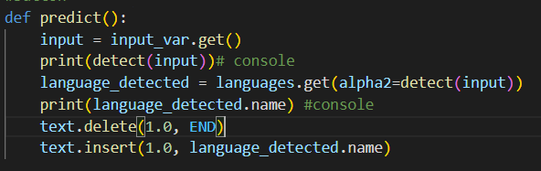
Function to predict the language

Slide 9
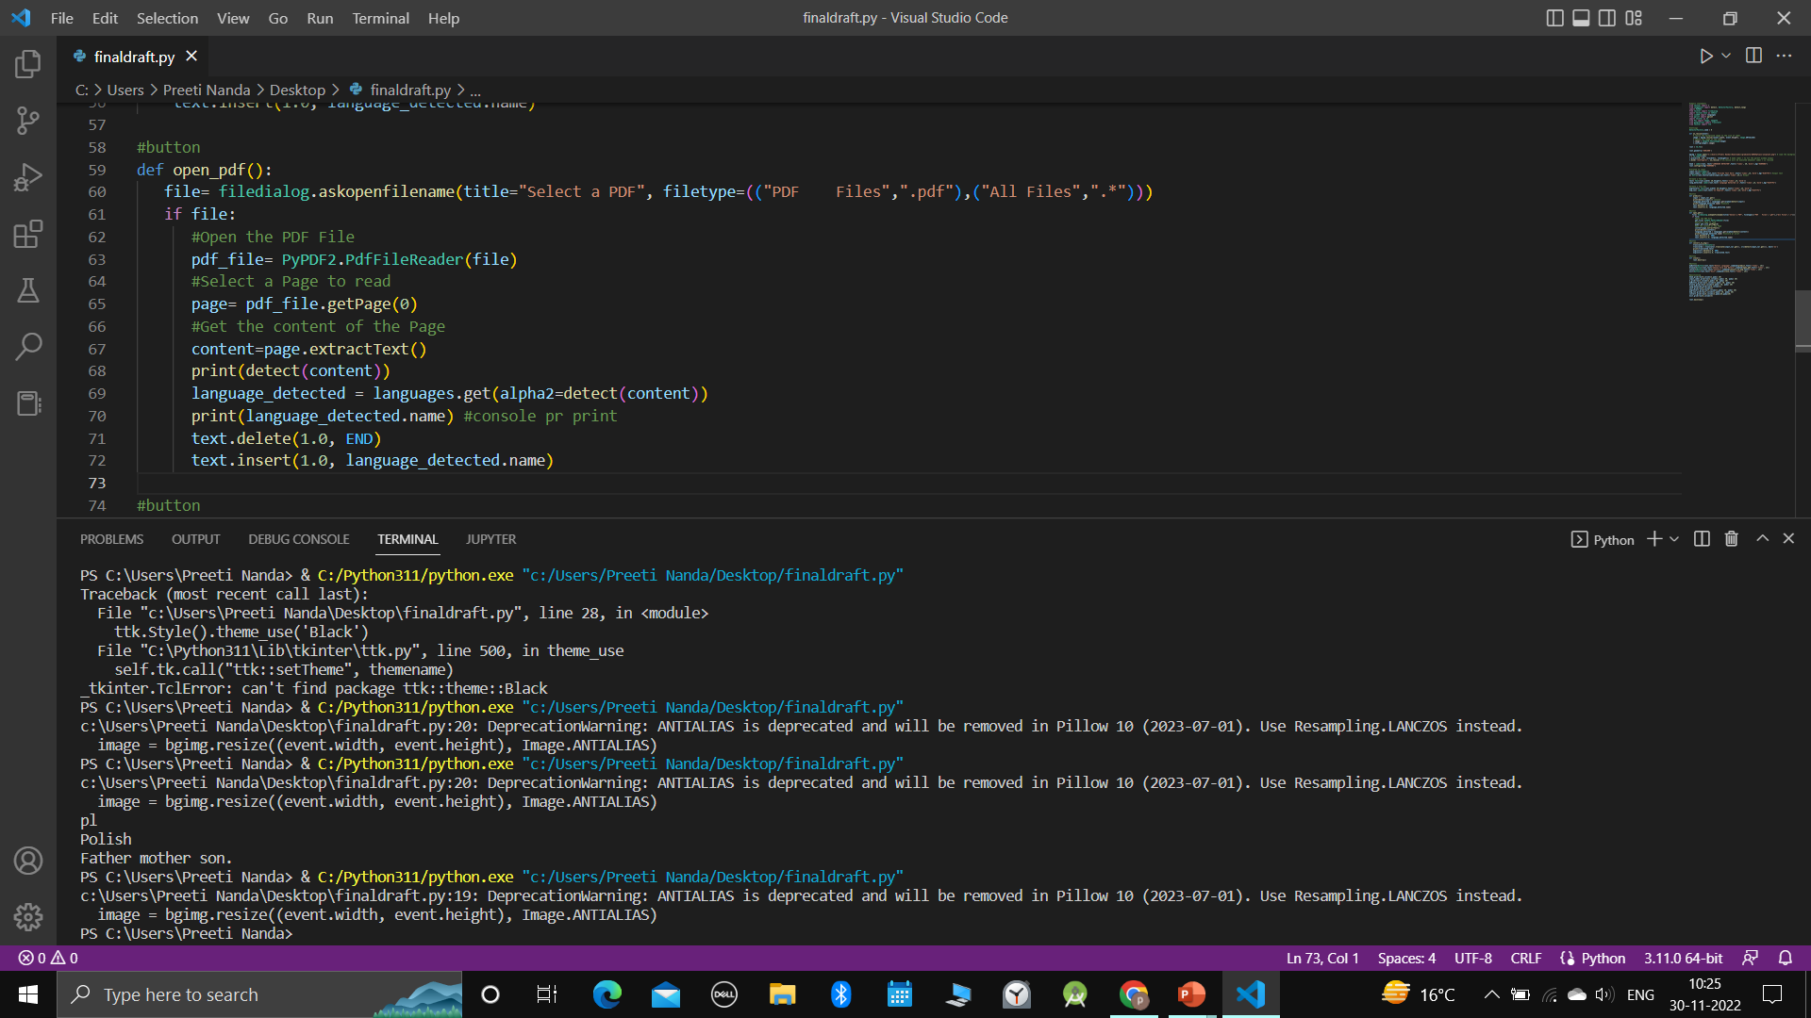
Function to read pdf and detect the language

Slide 10
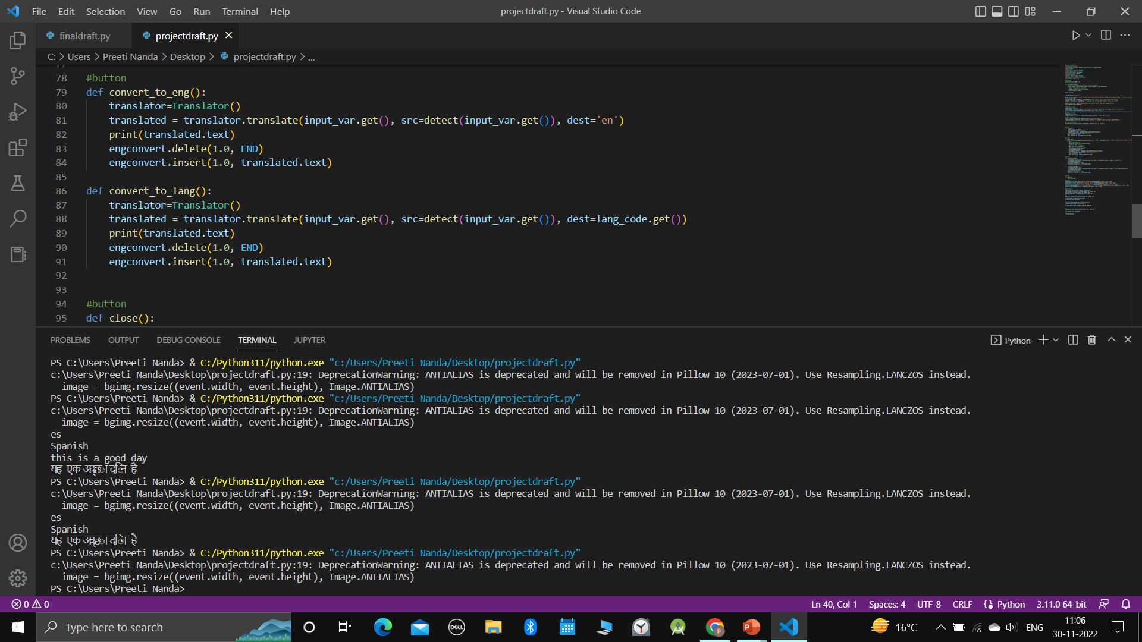
Function to convert language

Slide 11
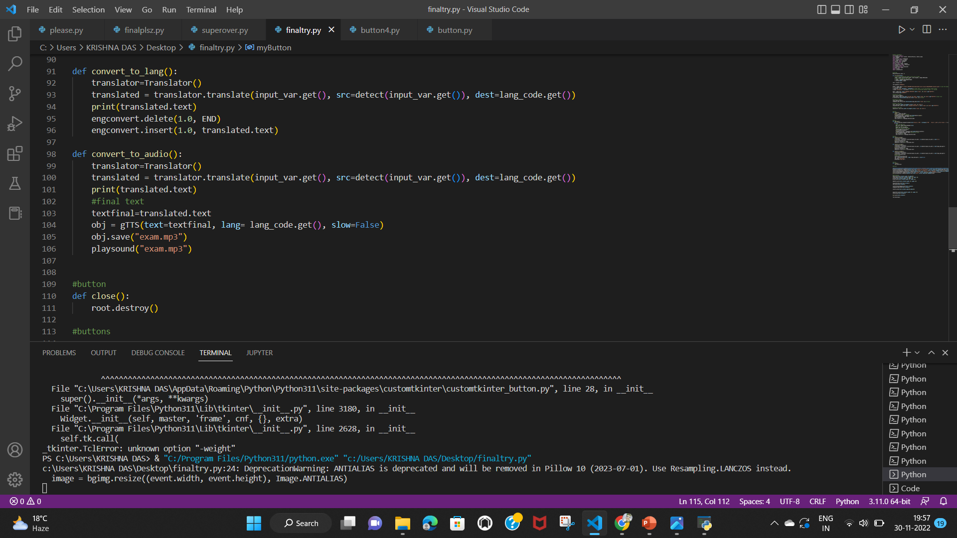
Function to Give Audio Output

Slide 12
!!!
Lets run the program

Slide 13
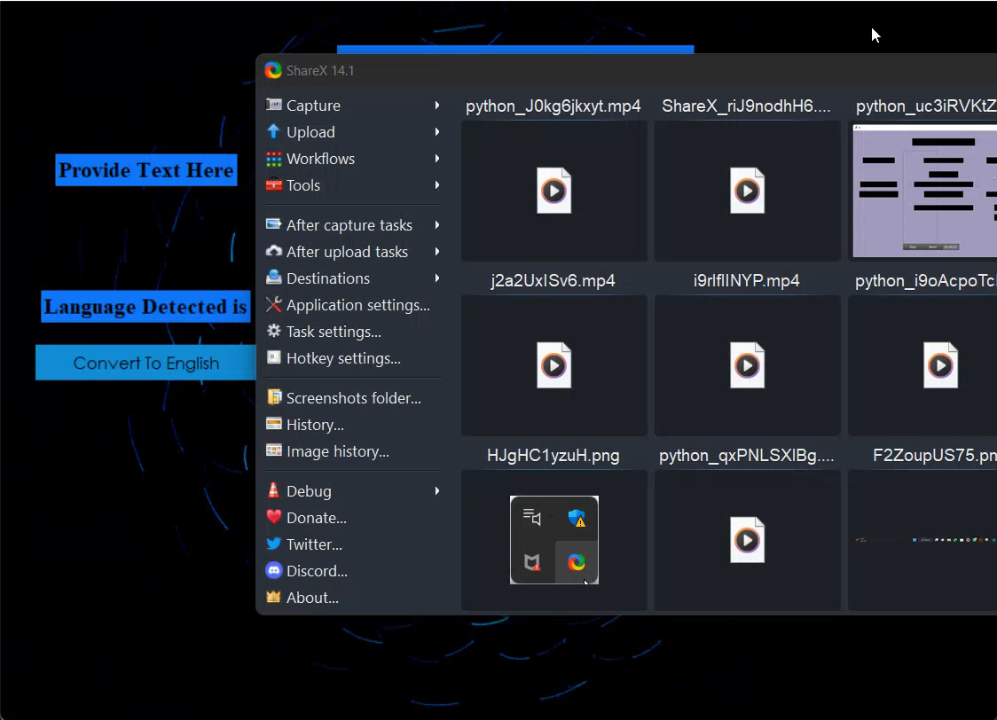

Slide 14
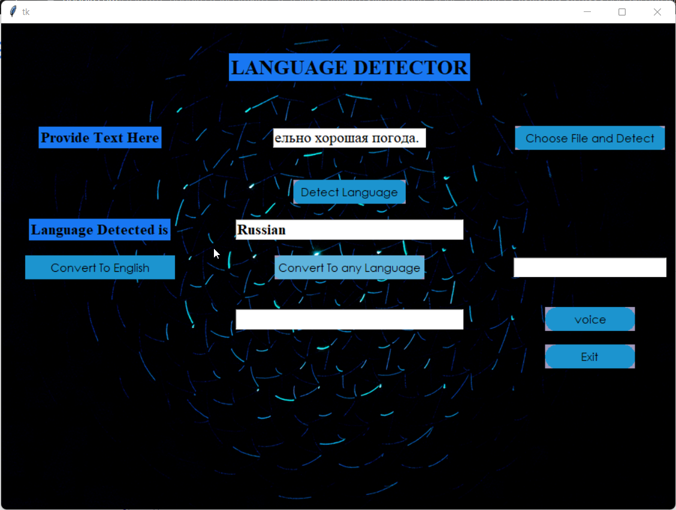

Slide 15
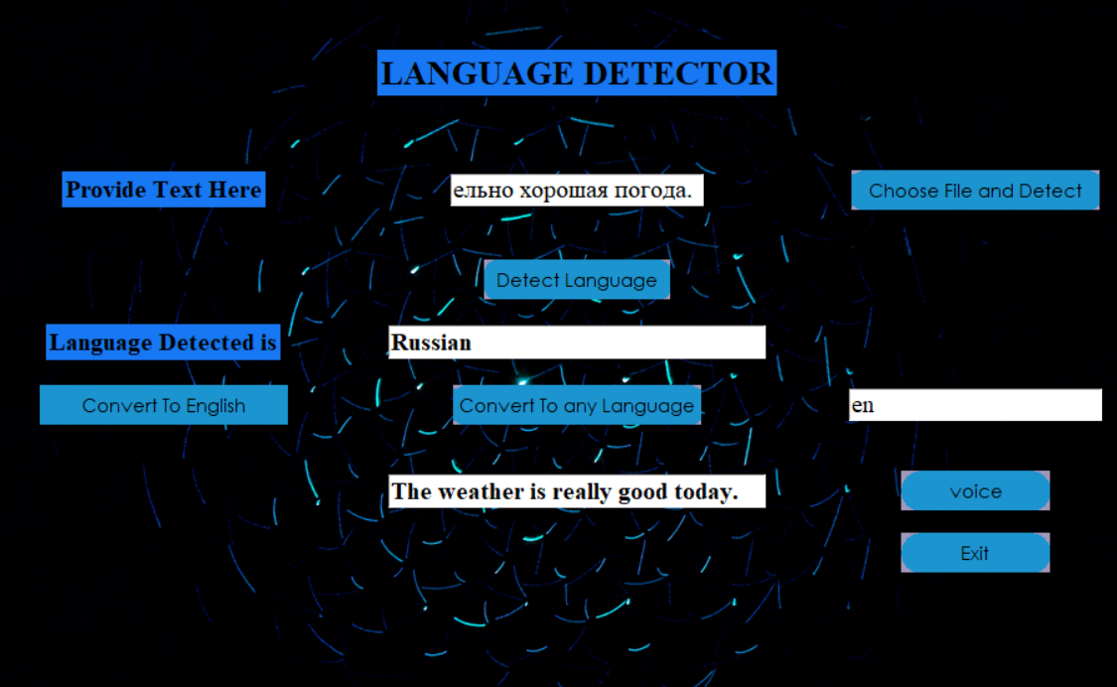

Slide 16
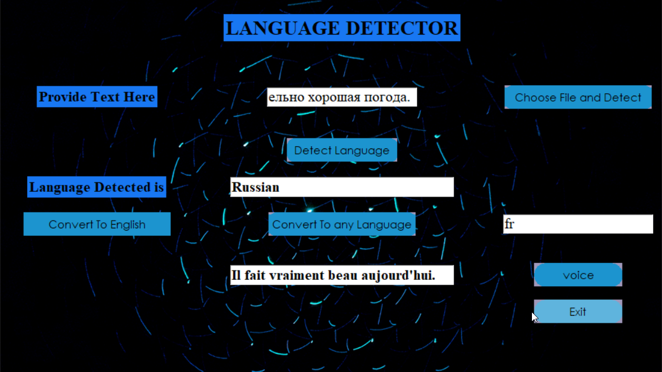

Slide 17
!!!
THANK YOU

